Slide 1

Week 6: Sequence Data Analysis and RNN
Part 2- RNN
Dr Maha Saadeh

Slide 2
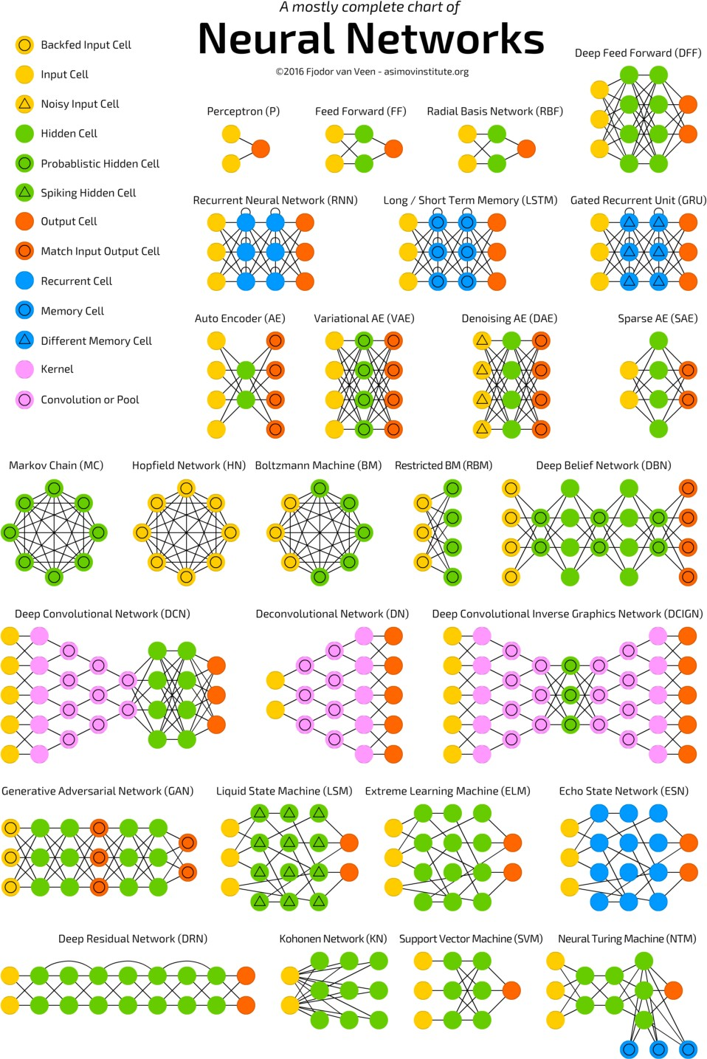
The Neural Network Zoo
www.asimovinstitute.org/author/fjodorvanveen/

Slide 3
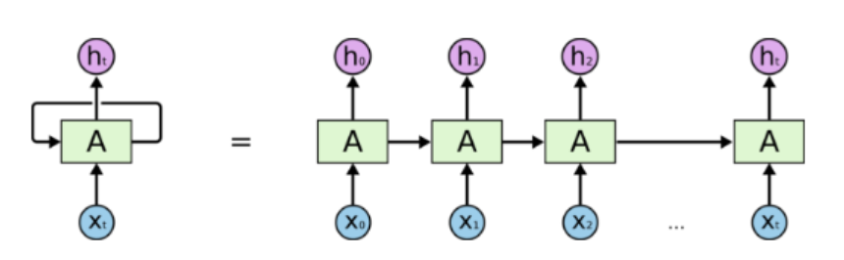
Recurrent Neural Networks (RNNs)
Recurrent Networks
Operate on sequences of input vectors
Nodes connect back to other nodes or themselves
Information flow is multidirectional
Sense of memory of previous state(s)

Slide 4
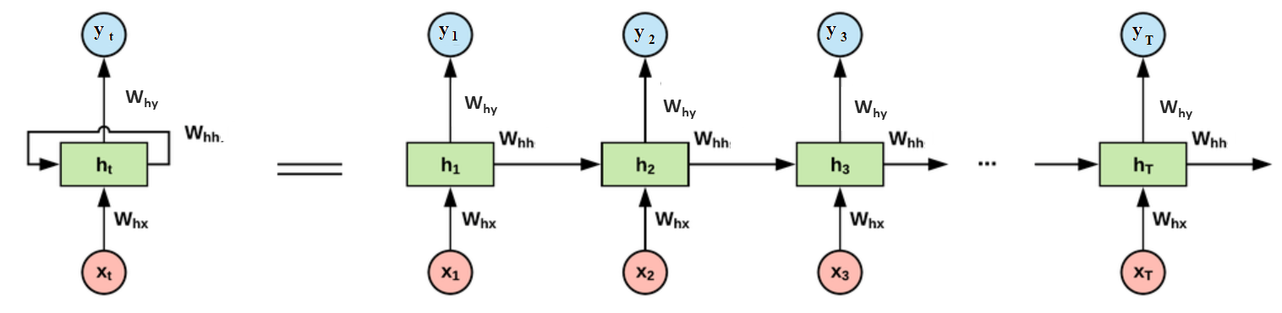
Recurrent Neural Networks (RNNs)

Slide 5
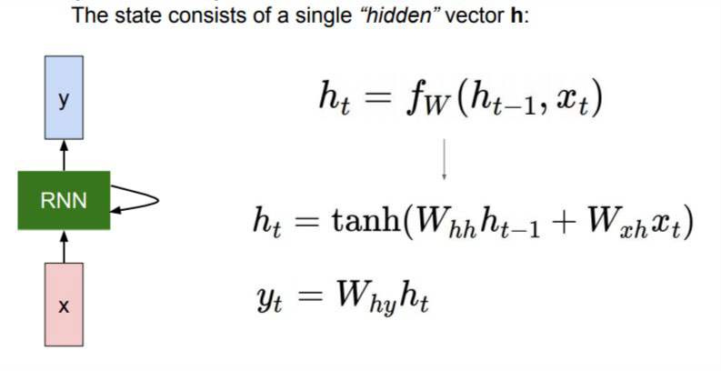
Recurrent Neural Networks (RNNs)
W is weight, h is the single hidden vector, W_{hh} is the weight at previous hidden state, W_{hx} is the weight at current input state, tanh is the Activation funtion, that implements a Non-linearity that squashes the activations to the range[-1 , 1]
Y_{t} is the output state. W_{hy} is the weight at the output state.
Slide by Fei-Fei Li et al.

Slide 6
Recurrent Neural Networks (RNNs)

Slide 7
Recurrent Neural Networks (RNNs)

Slide 8
Recurrent Neural Networks (RNNs)

Slide 9


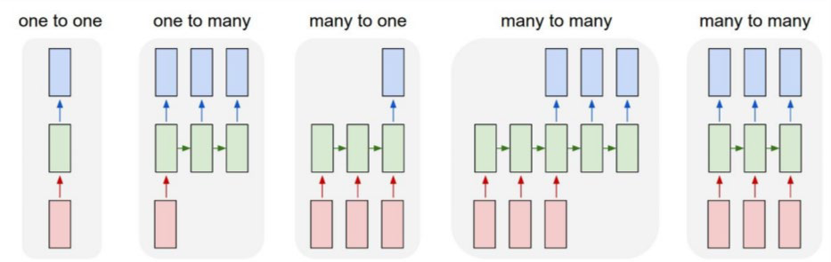






RNN – mapping sequences
Slide by Fei-Fei Li et al.

Slide 10
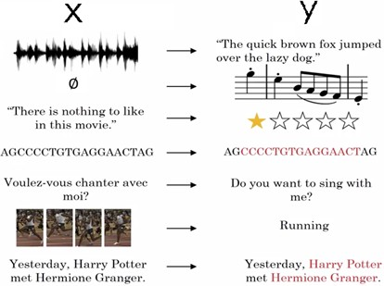
Applications of RNNs
Speech recognition (many-to-many)
Sentiment analysis (many-to-one)
Machine translation (many-to-many)
Video activity recognition (many-to-one)
POS Tagging in NLP (many-to-many)
Image captioning (one –to-many)

Slide 11
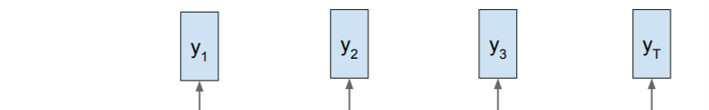
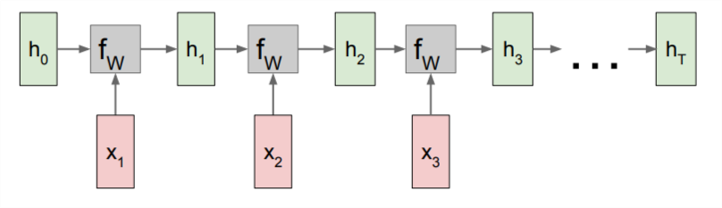
Training an RNN
Label 1
Label 2
Label 3
Label t
Slide by Fei-Fei Li et al.

Slide 12


Training an RNN
Loss 1
Loss 2
Loss 3
Loss t
Label 1
Label 2
Label 3
Label t
Slide by Fei-Fei Li et al.

Slide 13





Training an RNN
Sum
Total loss
Loss 1
Loss 2
Loss 3
Loss t
Label 1
Label 2
Label 3
Label t
Slide by Fei-Fei Li et al.

Slide 14
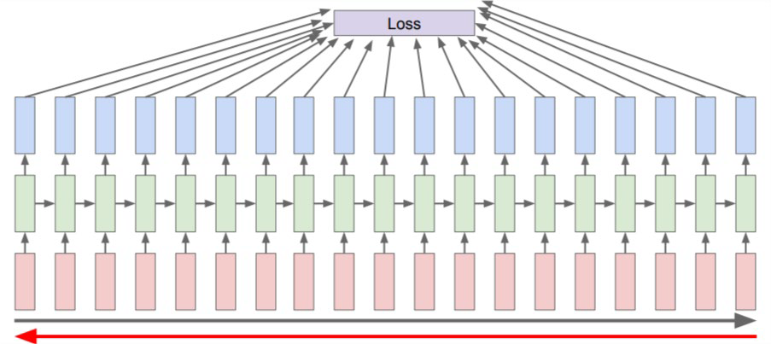
Backpropagation Through Time (BPTT)
Forward through entire sequence to compute the loss function, then backward through the entire sequence to compute gradient
Deep network
Problem of vanishing gradients
when the gradient becomes too small, the parameter updates become insignificant. This makes the learning of long data sequences difficult.

Slide 15
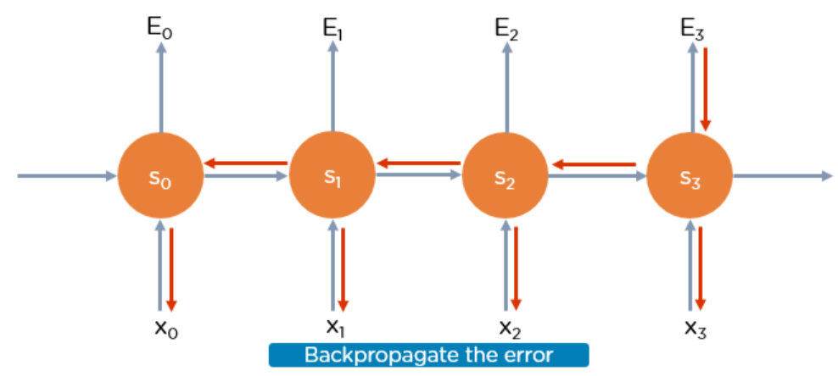
Training RNN

Slide 16
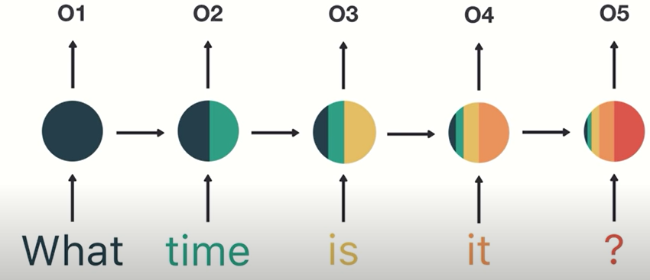

Short Memory Problem
long-distance dependencies in sequence data
As the RNN processes more steps, it has to pass information from previous steps, so the end state may not remember the information from the early states so these information are not considered when we do the prediction.

Slide 17
Short Memory Problem
Long-Distance Dependencies
Example: Suppose you want to predict the last word in the text:
“The Sun is in the ______.” The most obvious answer to this is the “sky.”
Now, Consider this sentence: “I have been learning English for more than 10 years, I can speak fluent ______.”
The word you predict will depend on the previous few words in context. Here we need the context of English to predict the word “English.”
Notice the gap between the relevant information and the point where it's needed. This is Long-Distance Dependencies

Slide 18
RNN Variant
Gated RNNs

Slide 19
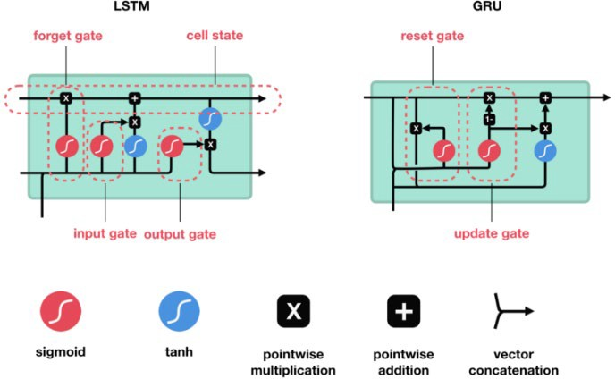
Gated RNNs
Help to solve short memory problems
Gates to control the information flow

Slide 20
LSTM
LSTMs are a special kind of Recurrent Neural Network — capable of learning long-term dependencies by remembering information for long periods is the default behavior.
Just like the traditional RNN, LSTMs also have a chain-like structure, but the repeating module is a bit different structure.

Slide 21
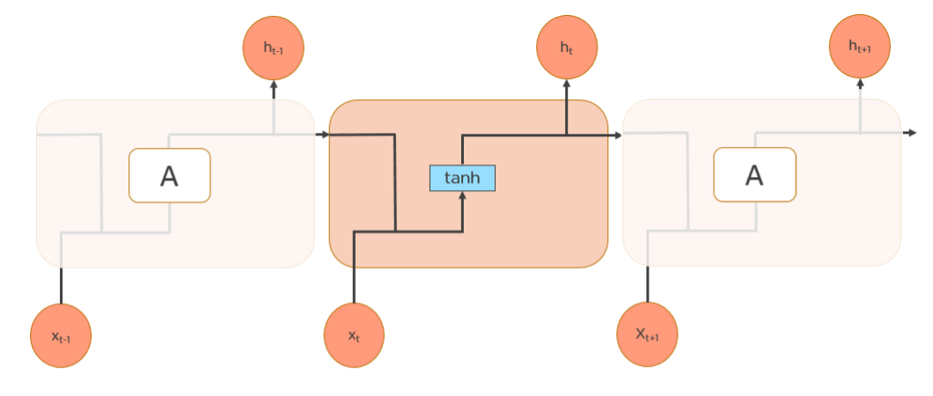
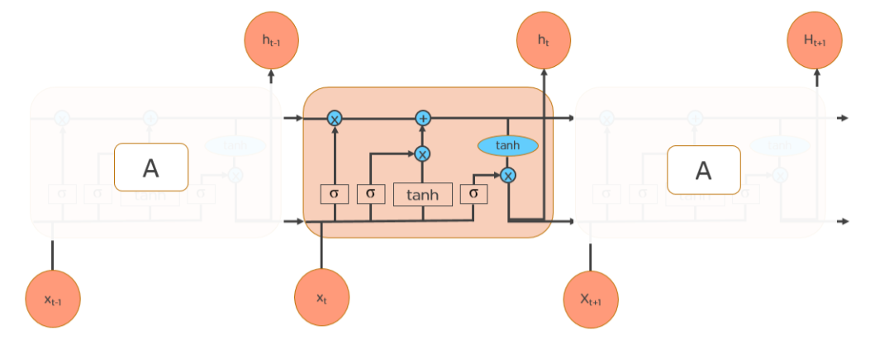
LSTM Vs RNN

Slide 22
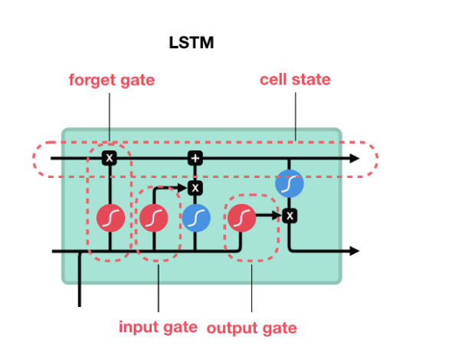
LSTM Structure

Slide 23
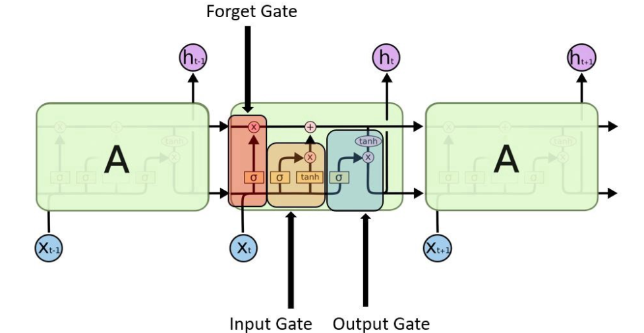
LSTM Gates
The gates decide which information is allowed on the cell state

Slide 24
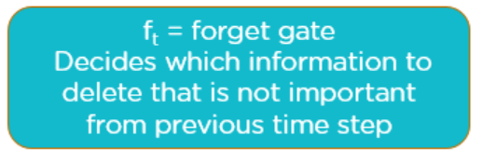
LSTM Gates
The forget gate: Decide how much past data it should remember. This is calculated using Sigmoid function, so if the result is mapped to 0, then it will be deleted.

Slide 25
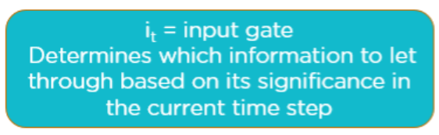
LSTM Gates
The input gate: Decide how much this unit adds to the current state

Slide 26
LSTM Cell
The Cell : The cell state act as a transport highway that transfers relative information all the way down the sequence chain. You can think of it as the “memory” of the network.

Slide 27
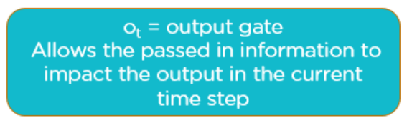
LSTM Gates
The output gate: Decide what part of the current cell state makes it to the output

Slide 28
Python Example
RNN

